Slide 1
An Introduction to Apache Spark

Slide 2
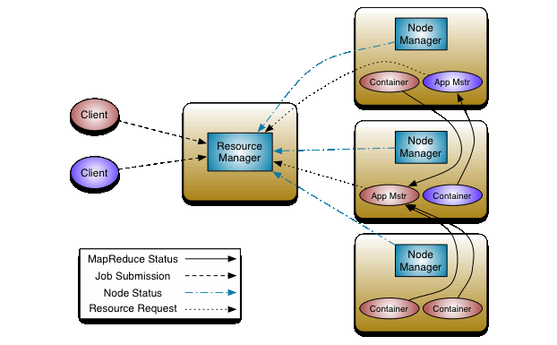
Spark Architecture

Slide 3
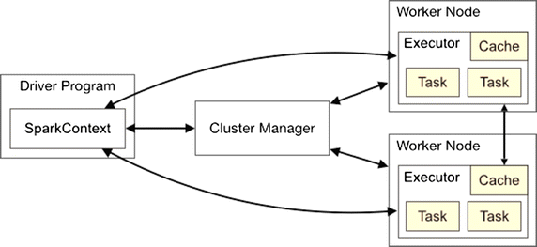
Spark Architecture

Slide 4
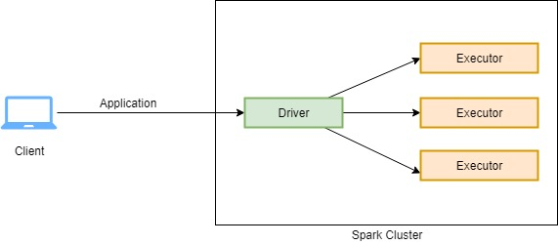
Apache Spark Execution
For every application submitted on spark cluster, spark creates a dedicated Driver process and bunch of Executor processes.
Driver process is responsible for analyzing, distributing, scheduling and monitoring of executor processes.
Whereas the executor process is only responsible for running the task they were assigned by drivers and reporting the status back to the driver.

Slide 5
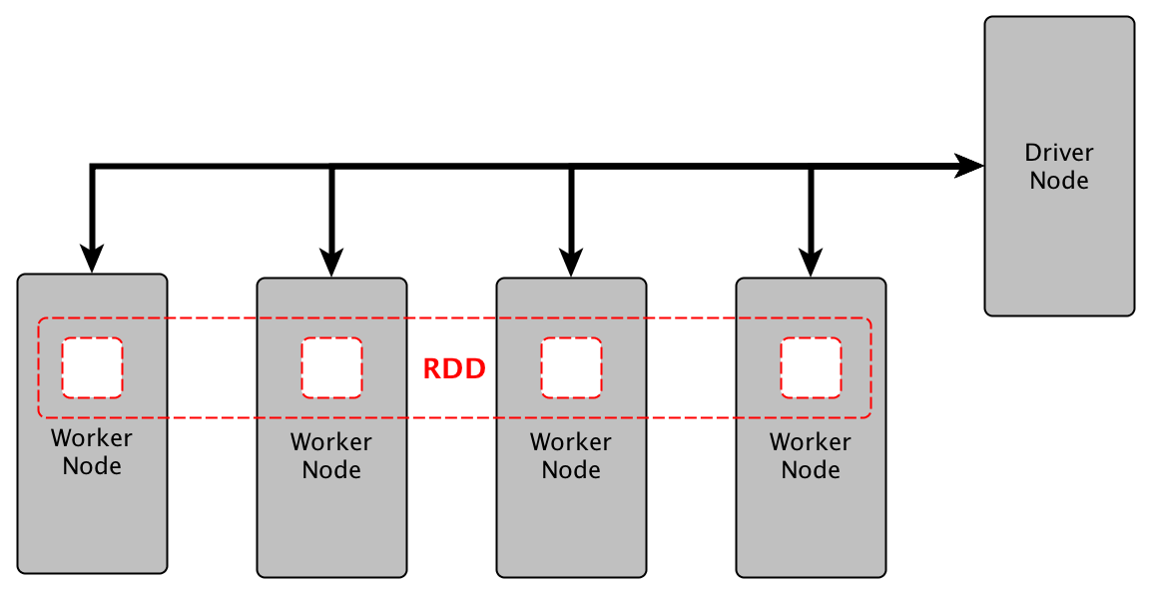
Apache Spark Execution

Slide 6
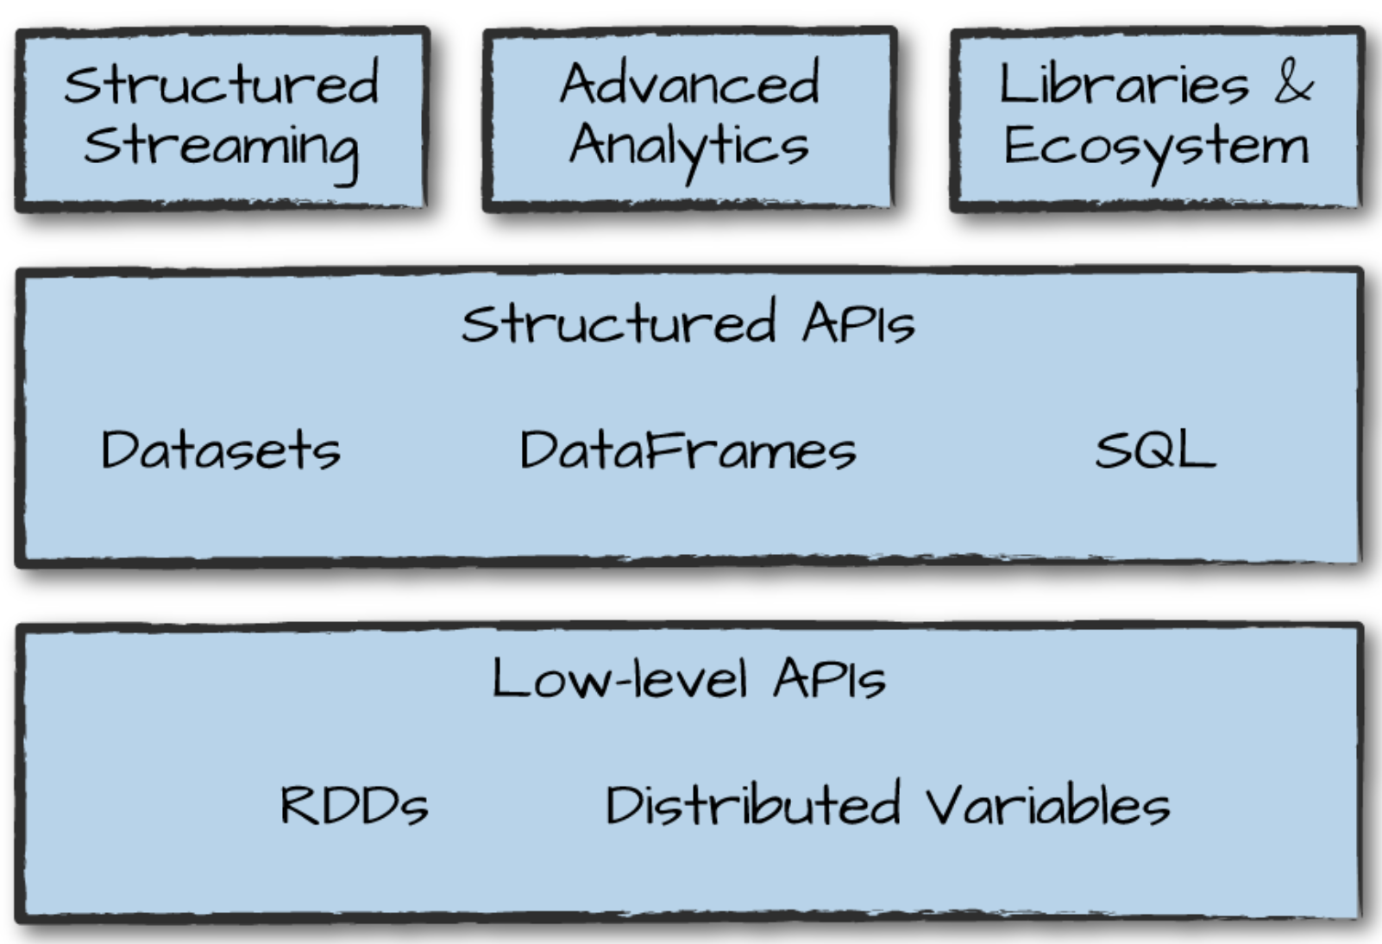
Spark’s Language APIs

Slide 7
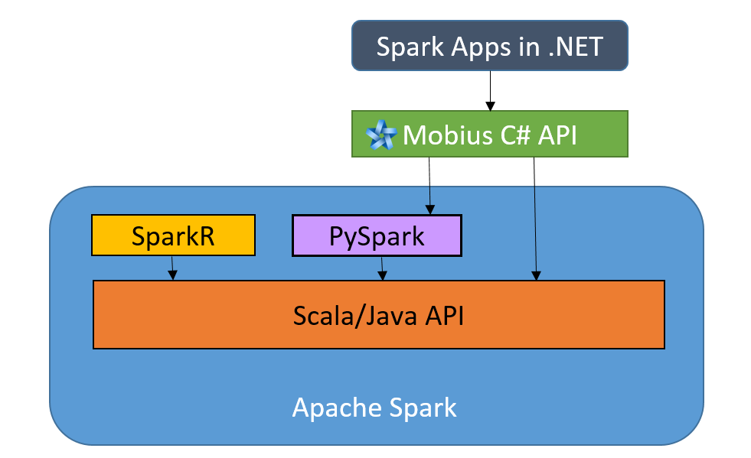
Spark’s Language APIs

Slide 8
SparkSession
Before understanding spark-session let’s understand the entry-point
An entry-point is where control is transferred from the operating system to the provided program.
Before 2.0 entry-point to spark-core was the sparkContext.
Apache Spark is a powerful cluster computing engine, therefore it is designed for fast computation of big data.
In previous versions, spark context is the entry point for spark
For streaming we needed streamingContext.
For SQL sqlContext and for hive hiveContext.
So in spark 2.0, we have a new unified entry point.

Slide 9
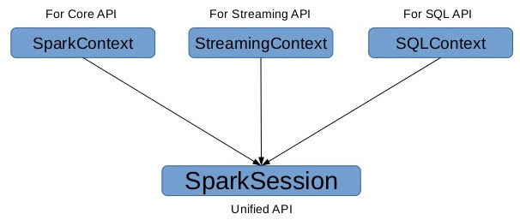
The SparkSession

Slide 10
DataFrames
In Apache Spark, a DataFrame is a distributed collection of rows
It has below characteristics:
Immutable in nature
We can create DataFrame RDD once but can’t change it.
Lazy Evaluations
Which means that a task is not executed until an action is performed.
Distributed

Slide 11
Why DataFrames are Useful?
Designed for processing large collection of data.
Has the ability to handle petabytes of data.
Has API support for different languages like
Python,
R,
Scala,
Java.

Slide 12
Create a DataFrame
Can be created using different data formats:
JSON
CSV
XML
Excel
By loading data from Existing RDD
By Programmatically specifying schema

Slide 13
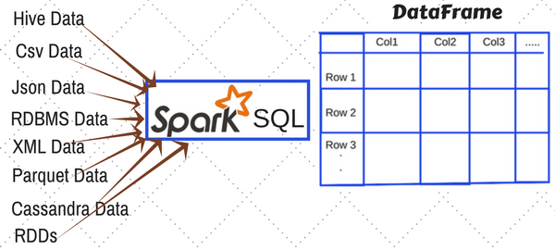
Ways to create DataFrame in Spark

Slide 14
Creating DataFrame from RDD
from pyspark.sql import Row
l = [('Ankit',25),('Jalfaizy',22),('saurabh',20),('Bala',26)]
rdd = sc.parallelize(l)
people = rdd.map(lambda x: Row(name=x[0], age=int(x[1])))
schemaPeople = sqlContext.createDataFrame(people)
type(schemaPeople)
#Output:
#pyspark.sql.dataframe.DataFrame

Slide 15
Thanks

Slide 16
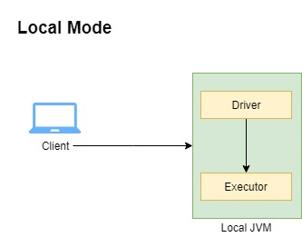
Apache Spark Execution – Local Mode
There is another mode in which spark can be run locally without any cluster requirement.
This mode is suitable for scenarios when we do not have enough resources to create cluster.
But in this mode you get only one executor and both the Driver and Excuter runs in the same JVM.

Slide 17
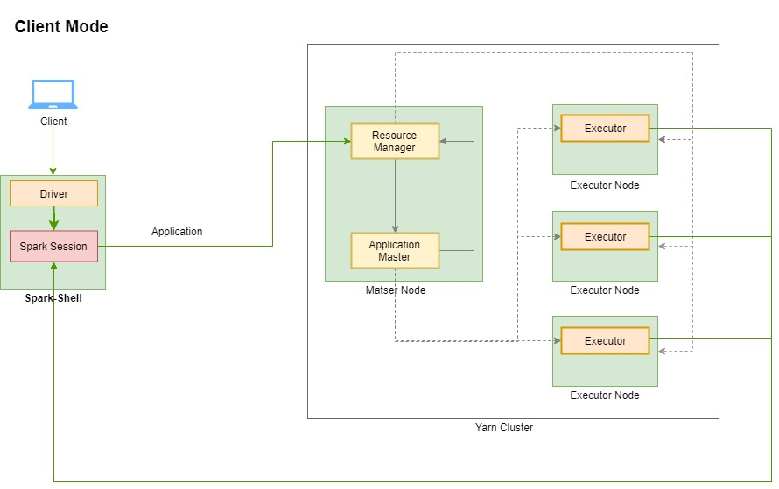
Apache Spark Execution – Client Mode

Slide 18
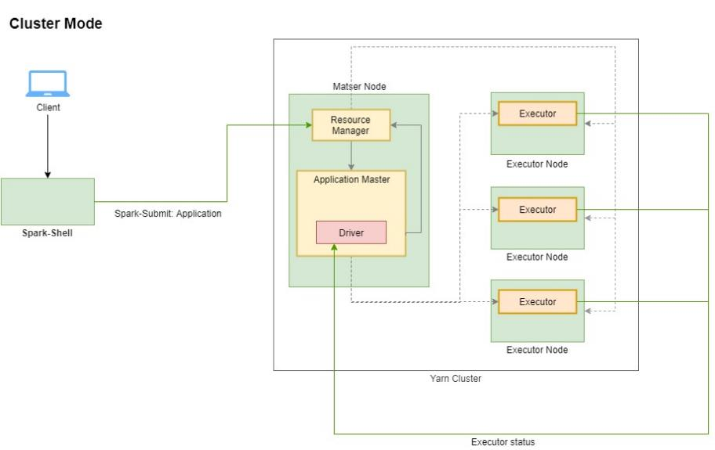
Apache Spark Execution – Cluster Mode

Slide 19
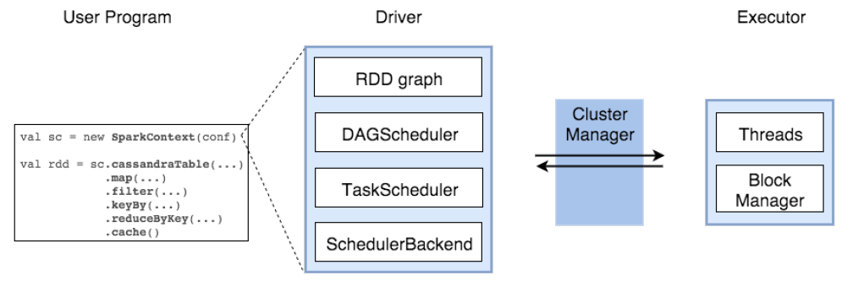

Slide 20
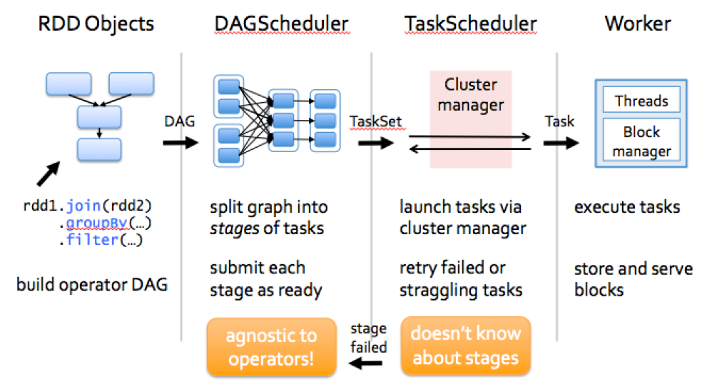
How Sparks work?

Slide 21
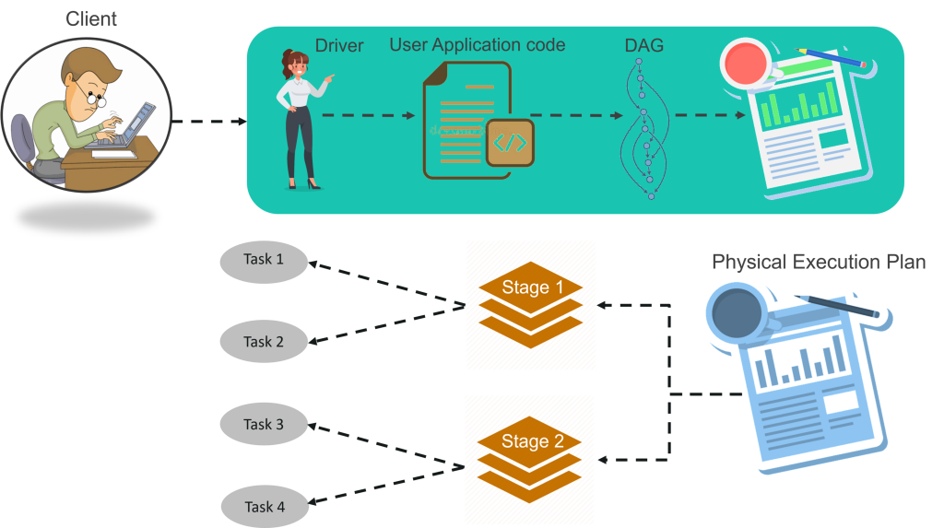

Slide 22
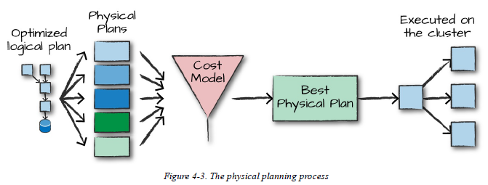
Catalyst Optimizer

Slide 23
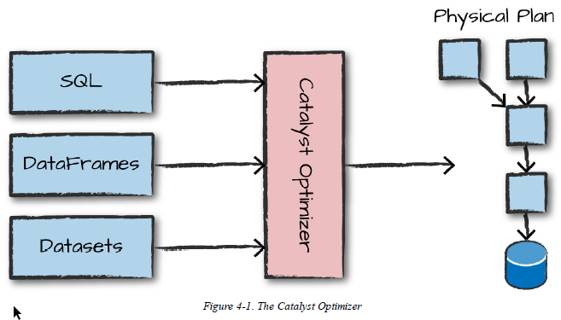
Catalyst Optimizer

Slide 24
